Slide 1


Slide 2

Basics of Insurance

Slide 3

What is Insurance?
Insurance is a financial product that reduces or eliminates the cost of probable loss of life or some asset.
Insurance is a risk transfer tool. By taking an insurance policy, you transfer risk to insurance company.
Insurance company assumes risk against premium paid by many persons.
Insurance company pays to those who actually suffer the loss and claim.

Slide 4
Why Insurance?
Insurance does not reduce the probability of occurrence of adverse events
Certain insurance are mandatory, e.g. motor insurance
It just helps you to manage the financial impact or amount of loss if the adverse event actually take place
Buying certain type of insurance helps in saving income tax also, e.g. life insurance and health insurance
Remember
Insurance should not be taken just for saving tax
Insurance should not be taken as investment primarily

Slide 5
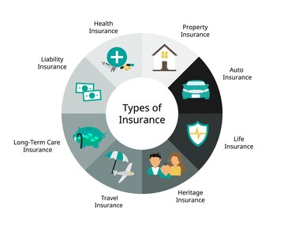
Popular Types of Insurance
Life Insurance
Non-Life or General Insurance
Term insurance
Whole life
Endowment
Unit Linked Insurance Plan or ULIP
Money back
Retirement plan
Child Insurance
Annuity or Pension plan
Health Insurance
Travel Insurance
Motor Insurance
Home Insurance

Slide 6


Insurance Sector in India
Insurance Regulatory and Development Authority of India (IRDAI) is the regulator.
There are many players offering numerous products to suit various needs.
24
IRDAI
28
General Insurers
Life Insurers

Slide 7
Do You need Insurance?
You need insurance if you feel that the financial impact or amount of loss on account of occurrence of the adverse event will be difficult to manage.
Example -
You need to buy life insurance policy if you are the one of the earning member of your family. You do not buy Life Insurance because you are going to die. You buy life insurance because someone else is going to live after you and they will need money.
You need to buy health insurance if you or your family member may fall sick, and the expected cost of treatment will be difficult for you to be bear.

Slide 8

What is Free Look Period?
It is period during which a policy holder can review the policy terms and if not satisfied, may return the policy with any penalty or charge.
Certain expenses like medical check-up expenses incurred, stamp duty paid etc. can be recovered by insurance company.
15 days Free Look Period is available for all Life Insurance policies after date of issuance of policy.
It is available for health insurance policies which a term of at least three years.
If any claim is made before the end of the Free Look period, then policy cannot be returned.

Slide 9
What is the Grace Period?
Grace period is additional time the insurance provider gives after the premium due date to pay your premium.
The grace period is 30 days if premium is paid annually. For other premium frequencies, its 15 days.
Life cover continues during the grace period.
Health insurance cover is not available during the grace period.

Slide 10
Life Insurance
Life insurance is a crucial financial tool designed to provide a safety net and financial security to the loved ones of the policyholder in the unfortunate event of the policyholder's death."
"It operates as a contractual agreement between the policyholder and the insurance company, wherein the policyholder pays premiums, and, in return, the insurer promises to pay a designated sum to beneficiaries upon the insured's death."
Purpose of life insurance:
"Beyond the emotional reassurance it brings, life insurance serves the practical purpose of ensuring the financial stability of dependents, protecting them from economic hardship after the policyholder's passing."

Slide 11
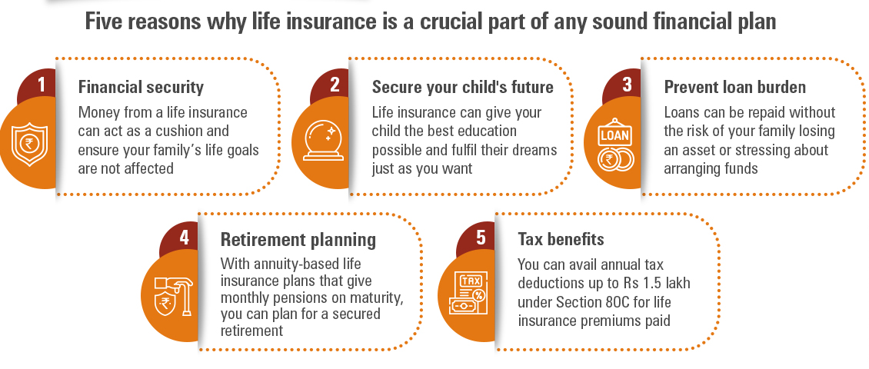
Life Insurance - Benefits
"Life insurance proceeds can cover immediate needs, such as funeral expenses, outstanding debts, and ongoing living expenses for the surviving family members.“
"Some life insurance policies, such as whole life and universal life, also accumulate cash value over time, providing a savings or investment component that policyholders can access during their lifetime."

Slide 12
Types of Life Insurance Policies
Whole Life Insurance:
"Offers coverage for the entire lifetime of the policyholder."
"Combines a death benefit with a cash value component that grows over time."
"Policyholders can access the cash value through loans or withdrawals.“
Term Life Insurance:
"Provides coverage for a specified term, typically 10, 20, or 30 years."
"Pure life coverage without cash value or investment features."
"Cost-effective solution for individuals seeking temporary coverage.“
Universal Life Insurance:
"Flexible policy allowing adjustments to the premium and death benefit."
"Accumulates cash value, offering potential for investment growth."
"Policyholders can vary the amount and frequency of premium payments."

Slide 13
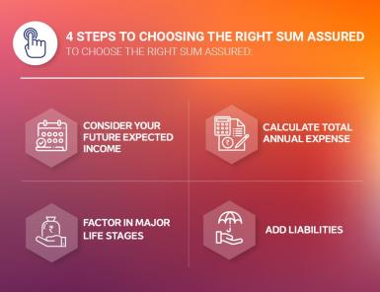
How to Choose Life Insurance Policy?
Important parameters which one should consider before selecting a life insurance policy -
Your current income and expenses
How much money your family may need when you are not there?
How much premium you can afford?
Insurer’s claim settlement record
Policy exclusions

Slide 14
Life Insurance Policy
In the event of your death, a life insurance policy could help:
Distribute money to your beneficiaries.
Pay off your mortgage so that the house is free and clear of debt.
Provide for your children’s college education.
Pay for the final expenses of a funeral or estate settlement costs.
Provide an emergency fund to handle an unexpected financial crisis.
Provide for settlement of your personal debts.

Slide 15
Term insurance
Introduction:
"Term plans, or term life insurance, are designed to offer straightforward coverage for a defined period, typically 10, 20, or 30 years. They provide a cost-effective solution for individuals seeking temporary coverage without the added complexities of investment components.“
Advantages of term plans:
Affordability: "Term life insurance is known for its affordability, making it a practical choice for individuals and families looking to secure significant coverage without straining their budget. This affordability allows a broader demographic to access essential life insurance protection.“
Flexibility: "Term plans offer flexibility in coverage duration and amount, allowing policyholders to tailor their insurance to specific life stages and financial obligations. This adaptability makes term life insurance a versatile and customizable option for varying life circumstances.“
Financial Protection During Critical Periods: "Term life insurance provides crucial financial protection during periods of heightened vulnerability, such as the duration of a mortgage, raising children, or when dependents are still financially reliant. It acts as a dedicated safety net during these critical years."

Slide 16
Term insurance
Ideal scenarios for term plans:
"Young families: Term plans are often recommended for young families looking to ensure financial protection during critical years of child-rearing and mortgage payments."
"Short-term financial obligations: Individuals with specific financial obligations like education loans or short-term debts can benefit from the targeted coverage of term plans."
Considerations when choosing term plans:
"Coverage duration: Selecting a term aligned with your financial goals and responsibilities is crucial. Consider factors like the duration of major financial obligations and the time until dependents become financially independent."
"Convertibility options: Some term plans offer the ability to convert to permanent life insurance policies in the future, providing flexibility as your financial situation evolves."

Slide 17
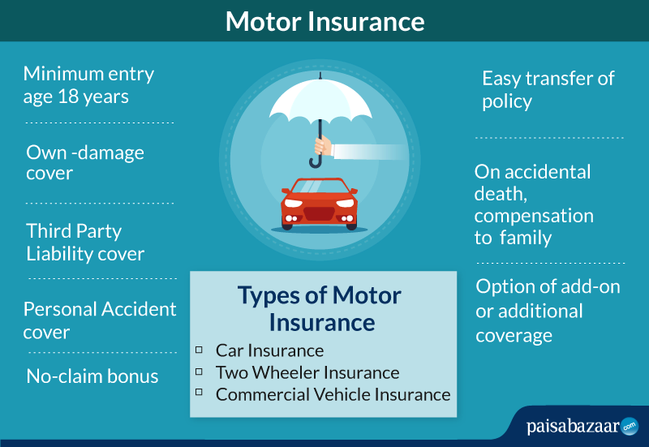
Vehicle insurance
Critical Financial Shield:
"Vehicle insurance stands as a critical shield, providing essential financial protection against the unpredictable events that can lead to significant monetary loss.“
"Whether it's an accident, theft, or damage to the insured vehicle, having robust vehicle insurance ensures that the financial burden is significantly alleviated."

Slide 18
Vehicle insurance - Coverage Options And Premium Factors
Understanding Coverage Trio:
"To tailor protection to specific needs, it's essential to grasp the trio of coverage options: comprehensive, collision, and liability coverage."
"Comprehensive coverage protects against non-collision events like theft or natural disasters, collision coverage addresses damage from accidents, and liability coverage covers costs associated with third-party injuries or property damage.“
Factors Affecting Premium Rates:
"Various factors intricately shape the cost of premiums in vehicle insurance."
"Age, vehicle type, driving history, and other considerations play a pivotal role in determining premium rates, highlighting the need for individuals to be aware of these variables and their impact on insurance costs."

Slide 19
Health Insurance - Introduction
The Role of Health Insurance in Comprehensive Financial Planning:
"Health insurance takes center stage as a fundamental element in comprehensive financial planning. It serves as a crucial safety net, offering protection against the escalating costs associated with healthcare.“
Financial Security in Healthcare Expenses:
"As medical costs continue to rise, health insurance provides individuals and families with a vital layer of financial security. It ensures that the financial burden of medical treatments, surgeries, and hospital stays is mitigated, preventing individuals from facing overwhelming out-of-pocket expenses.“
Preventive Care and Wellness:
"Beyond reactive measures, health insurance promotes proactive health management. It often includes coverage for preventive care, wellness checks, and screenings, encouraging a focus on maintaining good health and catching potential issues early.“
Accessibility to Quality Healthcare:
"Health insurance facilitates access to quality healthcare services. Individuals with coverage are more likely to seek timely medical attention, contributing to better health outcomes and reducing the risk of more severe health issues in the long run.“

Slide 20
Health Insurance - Coverage Areas and Significance
Encompassing a Wide Array of Medical Expenses:
"Health insurance spans a comprehensive range of medical expenses, covering everything from hospitalization and outpatient services to essential preventive care. This broad coverage ensures that policyholders are protected across various healthcare needs.“
Significance in Today's Context:
"In today's era of health uncertainties, the significance of robust health insurance cannot be overstated. The unpredictable nature of health challenges makes having comprehensive health coverage indispensable for securing not only physical well-being but also financial health.“
Navigating Health Uncertainties:
"Health insurance becomes a vital tool for navigating uncertainties related to health. It provides a financial cushion, allowing individuals to focus on recovery rather than worrying about the financial strain that healthcare expenses can impose.“
Adaptability and Customization:
"Modern health insurance plans often offer adaptability and customization, allowing individuals to tailor coverage to their specific health needs and preferences."

Slide 21
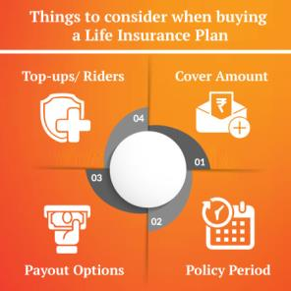
Health Insurance - How To Buy Insurance?
Important parameters which one should consider before selecting a health insurance policy -
Coverage of various diseases including pre-existing diseases
Minimum period of hospitalization required
Pre and post hospitalization expenses
Various limits and sub limits
Coverage of OPD expenses
Critical illness coverage
Exclusions
Cashless facility
Acceptability and network of empanelled hospitals
Cost of health check-up

Slide 22

Lapse Of Policies Revival
Insurance policy lapses when the insured defaults on the payments of renewal premium beyond grace period.
When the policy lapses, its benefits also lapse.
Insurance companies generally provide an option to reactivate the lapsed policy.
This option is generally available for a limited time – revival period, after the grace period.
During the revival period, the policy can be reinstated or revived subject to certain conditions such as payment of due premium with interest, proof of good health.
It’s a good feature using which policyholders can continue to enjoy policy benefits even when they might have missed the premium payment.
Revival of lapsed policy may be a cheaper option than buying a new cover.

Slide 23
THANK YOU

